Slide 1
Have / Has
have \ has

Slide 2
تستخدم HAS & HAVE للتعبير عن الملكية ( بمعنى لديه أو يمتلك) كالتالي:
تستخدم has مع الضمائر التالية:
has+ he/she/it
مثال
He has a car.
Ahmad has a car
She has a house.
Sara has a car
It(car) has 4 wheels

Slide 3
وتستخدم have مع الضمائر التالية
( have+ (they /we/ you / I)
مثال:
They have books.
We have Blue balls.
You have a nice mobile
I have two bicycles

Slide 4
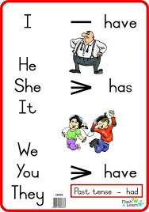

Slide 5
Please watch this video and be attention that you have a practice in the end
رجاءً شاهدوا هذا المقطع القصير ( مقطع الفيديو ) انتبهوا في نهاية المقطع يوجد تمارين :
https://www.youtube.com/watch?v=1Ner8zd7sJ0
عند الانتهاء من المشاهده انتقلوا لحل السؤال على دفاتركم.

Slide 6
Fill in with have or has in the following sentences :
-1 The boy ______ a ball.
-2 My sister ______ a boyfriend.
-3 I ______ two sisters. They blond hair.
-4 My brother______ a red car. It four doors.
-5 This house________ a very big garden.
-6 The boys _______ an important test tomorrow.
-7 My cat_______ a long tail.
-8 The book______ a nice cover.
-9 We _______ good news for you
-10 You_______ a nice voice.
Best Wishes
Shorouq kanaaneh

